Slide 1
Online Blockchain Based Certificate generation and validation for government organizations
Review-3
Batch Number: CSD-G29
Under the Supervision of,
Dr. Chandrasekar Vadivelraju
Assistant Professor
School of Computer Science and Engineering
Presidency University
Roll Number | Student Name
20211CSD0190 | Aneesh Gagan Raj
20211CSD0131 | Deepak U
20211CSD0164 | Gowtham R Gowda
20211CSD0153 | V Hemanth Kumar
Name of the Program: PSCS
Name of the HoD: Dr. Saira Banu Attam
Name of the Program Project Coordinator: Dr. Manjulla
Name of the School Project Coordinators: Dr. SAMPATH A.K

Slide 2
CONTENT
Introduction
Literature Survey
Existing Methods-Drawbacks
Proposed Method
Objectives
Architecture Diagram
Hardware and Software Details
Time Line by Gantt Chart
Conclusion
Github link
References

Slide 3
INTRODUCTION
In today’s digital world, the need for secure and tamper-proof digital documentation has become increasingly critical. Traditional certificate issuance systems are often vulnerable to forgery, loss, and inefficiency. To address these challenges, our project proposes a blockchain-based system for the online generation and validation of government-issued certificates.
Blockchain technology, with its decentralized and immutable nature, ensures that once a certificate is generated and recorded on the chain, it cannot be altered or duplicated. This project allows authorized government bodies to issue certificates digitally, which can then be verified by any third party without relying on a central authority. The transparency, security, and trustworthiness offered by blockchain make this system ideal for applications in education, identity verification, and public administration

Slide 4
LITERATURE SURVEY
Web-Based Dashboards: Enhance real-time project tracking and collaboration.
→ Alwan et al. (2022), IEEE Xplore
IoT for Real-Time Monitoring: Improves worker safety, equipment tracking, and site surveillance.
→ Chen et al. (2019), Computers in Industry
AI & Predictive Analytics: Helps predict project delays, cost overruns, and labour shortages.
→ Singh & Bansal (2022), Journal of Computing in Civil Engineering
Big Data in Construction: Enhances scheduling efficiency and resource allocation.
→ Zhang & Zhou (2020), Automation in Construction

Slide 5
LITERATURE SURVEY
Blockchain for Secure Transactions: Ensures transparent contracts and secure payments.
→ Taylor & Harris (2018), International Journal of Project Management
Cloud-Based Collaboration: Improves accessibility, real-time updates, and cost efficiency.
→ Sun & Lu (2019), Construction Innovation
Digital Twin Technology: Enables real-time tracking through virtual construction models.
→ Patel & Gupta (2021), Advanced Engineering Informatics

Slide 6
EXISTING METHODS-DRAWBACKS
Existing Methods:
Centralized Storage: Certificates are stored in centralized servers or databases managed by government departments.
2. Manual Certificate Generation: Government officials manually generate certificates based on citizen applications and documents.
3. Physical or PDF Format: Certificates are issued in physical copies or as downloadable PDF files.
4. No Tamper Protection: PDF or printed certificates can be easily forged or manipulated using simple editing tools.
5. Time-Consuming Verification: Verifying a certificate involves contacting the issuing authority, leading to delays and inefficiencies.

Slide 7
EXISTING METHODS-DRAWBACKS
Drawbacks:
1. Risk of Forgery: Manual reporting and periodic site visits can lead to inaccurate or outdated information, making it difficult to make informed decisions.
2. Lack of Real-Time Visibility: Traditional methods often lack real-time visibility into project progress, making it challenging to identify and address issues promptly.
3. Inefficient Communication: Manual reporting and disparate systems can lead to inefficient communication among stakeholders, causing delays and misunderstandings.
4. Data Silos: Spreadsheets and documents can create data silos, making it difficult to access and analyze project data in a comprehensive manner.
5. Limited Analytics and Insights: Traditional methods often lack advanced analytics and insights, making it challenging to identify trends, patterns, and areas for improvement.

Slide 8
PROPOSED METHODS
User Registration and Authentication
Citizens, government officials, and verifiers access the web application through a secure login system.
Role-based access is implemented to ensure that only authorized users can issue or verify certificates.
Certificate Request and Approval
The citizen submits a request for a certificate (e.g., birth, caste, income).
A government authority reviews and approves the request through the backend interface.
Certificate Verification
Any third party (like an employer or institution) can enter the certificate ID or scan the QR code through the web app.
The system fetches the hash from the blockchain and verifies its authenticity without needing a central authority.

Slide 9
PROPOSED METHODS
Certificate Generation and Hashing
Once approved, certificate details are hashed (to protect sensitive data) and stored on the blockchain via the smart contract.
A unique certificate ID or QR code is generated and shared with the user.
Optional Metadata Storage
While the certificate hash and proof are stored on-chain, additional non-sensitive user metadata can be stored in a database (e.g., MongoDB).
Frontend and Backend Integration
The frontend (HTML, CSS, JavaScript, Bootstrap) interacts with the Flask/Node.js backend, which connects to the blockchain via Web3.js or Web3.py.

Slide 10
OBJECTIVES
The project aims to achieve the following objectives:
To develop a secure and tamper-proof system for generating and managing government-issued certificates using blockchain technology.
To eliminate certificate forgery and duplication by leveraging the immutability and transparency of blockchain.
To enable real-time and trustless verification of certificates without the need for third-party validation or manual checks.
To design and deploy smart contracts that automate the certificate issuance and validation process based on predefined rules.

Slide 11
OBJECTIVES
To build a user-friendly web interface for citizens, government authorities, and third-party verifiers to interact with the system easily.
To store certificate data on a decentralized ledger ensuring high availability, data integrity, and resistance to tampering or loss.
To improve the efficiency and transparency of government services by digitizing certificate workflows and removing paperwork.
User Authentication: Implement a secure admin authentication system with role-based access control

Slide 12
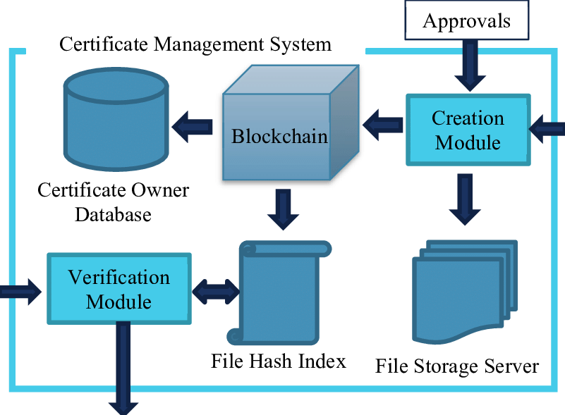
ARCHITECTURE DIAGRAM

Slide 13
HARDWARE AND SOFTWARE COMPONENTS
HTML, CSS, JavaScript – For building the user interface Bootstrap – For responsive design
Node.js / Python (Flask/Django) – For handling server-side logic and APIs
VS Code, Postman, Git.
Ethereum Test Network (e.g., Ropsten / Ganache) – For deploying and testing blockchain logic
Ganache , Truffle, MetaMask
MySql

Slide 14
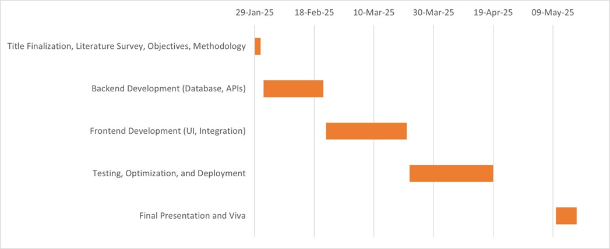
Timeline of the Project (Gantt Chart)

Slide 15
CONCLUSION
The project successfully demonstrates how blockchain technology can revolutionize the way government certificates are generated, stored, and validated. By leveraging the decentralized, transparent, and tamper-proof nature of blockchain, this system eliminates the risks associated with forgery, central data breaches, and manual verification.
Through the use of smart contracts, certificates can be issued automatically upon meeting predefined conditions, and any third party can verify them in real-time without depending on a central authority. This not only improves security and trust but also enhances efficiency and accessibility in public service delivery.
Overall, this project highlights the potential of blockchain as a transformative solution for secure and transparent digital governance.

Slide 16
GITHUB LINK
https://github.com/aneeshgaganraj/Online-Blockchain-based-Certificate-generation-and-validationts.
It’s a public repository and everything is accessible for everyone and there is a through road map how we are going to take this project further in a readme file in GitHub.

Slide 17
REFERENCES
1. S. Nakamoto, “Bitcoin: A peer-to-peer electronic cash system,” 2008. [Online]. Available:
https://bitcoin.org/bitcoin.pdf.
2. V. Buterin, “A next-generation smart contract and decentralized application platform,”
Ethereum White Paper, 2014. [Online]. Available: https://ethereum.org/en/whitepaper/.
3. F. Saleh, “Blockchain without waste: Proof-of-stake,” in Proc. IEEE Int. Conf. Blockchain
Cryptocurrency (ICBC), Sydney, NSW, Australia, May 2021, pp. 1–9, doi:
10.1109/ICBC51069.2021.9461132.
4. J. Benet, “IPFS - Content addressed, versioned, peer-to-peer file system,” arXiv preprint
arXiv:1407.3561, 2020. [Online]. Available: https://arxiv.org/abs/1407.3561.
5. S. Goldwasser, S. Micali, and C. Rackoff, “The knowledge complexity of interactive proof
systems,” SIAM J. Comput., vol. 18, no. 1, pp. 186–208, Feb. 2019, doi: 10.1137/0218012

Slide 18
REFERENCES
6. Zhang, X., & Zhou, Y. (2020).
Big Data Analytics for Construction Management. Automation in Construction, 119, 103293.
7. Taylor, J., & Harris, D. (2018).
Blockchain for Construction Supply Chain Management. International Journal of Project Management, 36(5), 795–805.
8. Sun, W., & Lu, H. (2019).
Cloud Computing for Real-Time Construction Project Monitoring. Construction Innovation, 19(3), 321–338.
10. Y. Zhang, S. Kasahara, Y. Shen, X. Jiang, and J. Wan, “Smart contract-based access control
for the Internet of Things,” IEEE Internet Things J., vol. 6, no. 2, pp. 1594–1605, Apr. 2019,
doi: 10.1109/JIOT.2018.2847705.

Slide 19


